Slide 1
Vax 2 Stop Cancer Families United to Stop HPV
Alabama Adolescent Vaccine Task Force
June 11, 2019

Slide 2
Vax 2 STOP Cancer
AIM:
VAX 2 STOP CANCER HPV initiative will be a single platform with a unifying message for all stakeholders interested in raising HPV vaccination rates in AL.
AIM
Notes:
No single organization has the focus or the budget to do this alone
We will meet the gaps in advocacy and policy.

Slide 3
Vax 2 STOP Cancer
VAX 2 STOP CANCER Board
Dr. Warner Huh, President American Gyn/Onc Society
Bob Crutchfield, American Cancer Society
Casey Daniel, USA Asst. Professor of Oncology Sciences
Dr. Bill Johnston, Birmingham Pediatrics
Scientific Advisors:
Dr. Peter J. Hotez, Baylor School of Medicine
Dr. Michael Saag, UAB, Director of Infectious Diseases
AIM

Slide 4
Vax 2 STOP Cancer
The Mission of
VAX 2 STOP CANCER
is to save lives by bringing education and awareness to the HPV vaccine and HPV-related cancers, fund research and improve vaccination rates.
Our Vision:
Eliminate HPV-related cancers in the state of Alabama through education and advocacy, reducing the high social, emotional, economic and medical costs associated with this disease. Our state will serve as a model to the rest of the nation, bringing our cancer rates from the top 10 to the lower tier.
AIM

Slide 5
Survey
Live survey
21 motivated pediatricians
Question delivered by respected peer
“What do you say to parents/patients regarding vaccination at the 11-12 year old visit?”
Expectation: majority would make the correct recommendation

Slide 6
HPV IQ
“Now that Michael is 11 he is due for vaccines against meningitis, HPV cancers and whooping cough. We will give those at the end of today’s visit.”
1. Presumptive
2. Treats all 3 vaccines the same
3. Focuses on cancer prevention
Recommendations for successful vaccination

Slide 7
Recommendation #1
Make a presumptive recommendation

Slide 8
Recommendation #2
Treat HPV vaccine like other vaccines

Slide 9
Recommendation #3
Focus on cancer prevention

Slide 10
Incorporated all 3

Slide 11
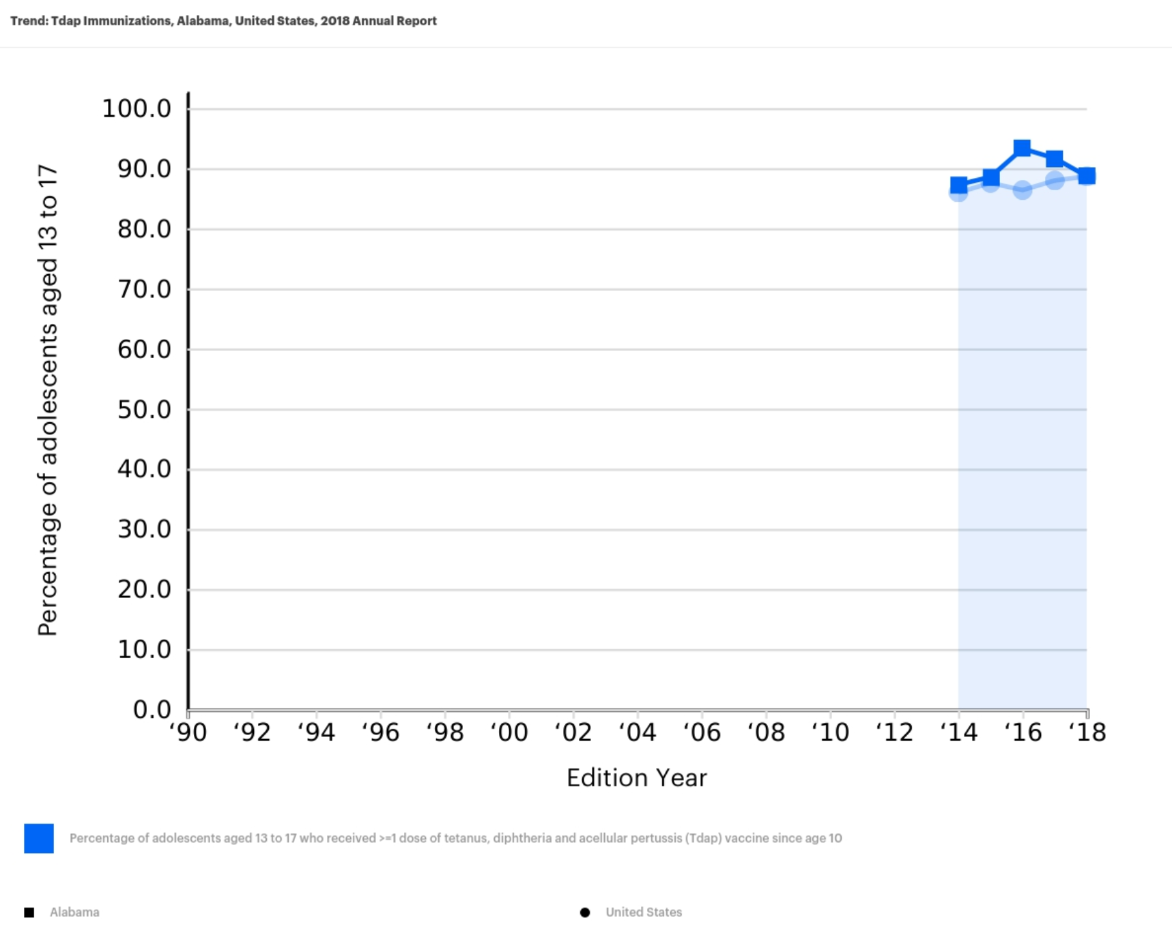
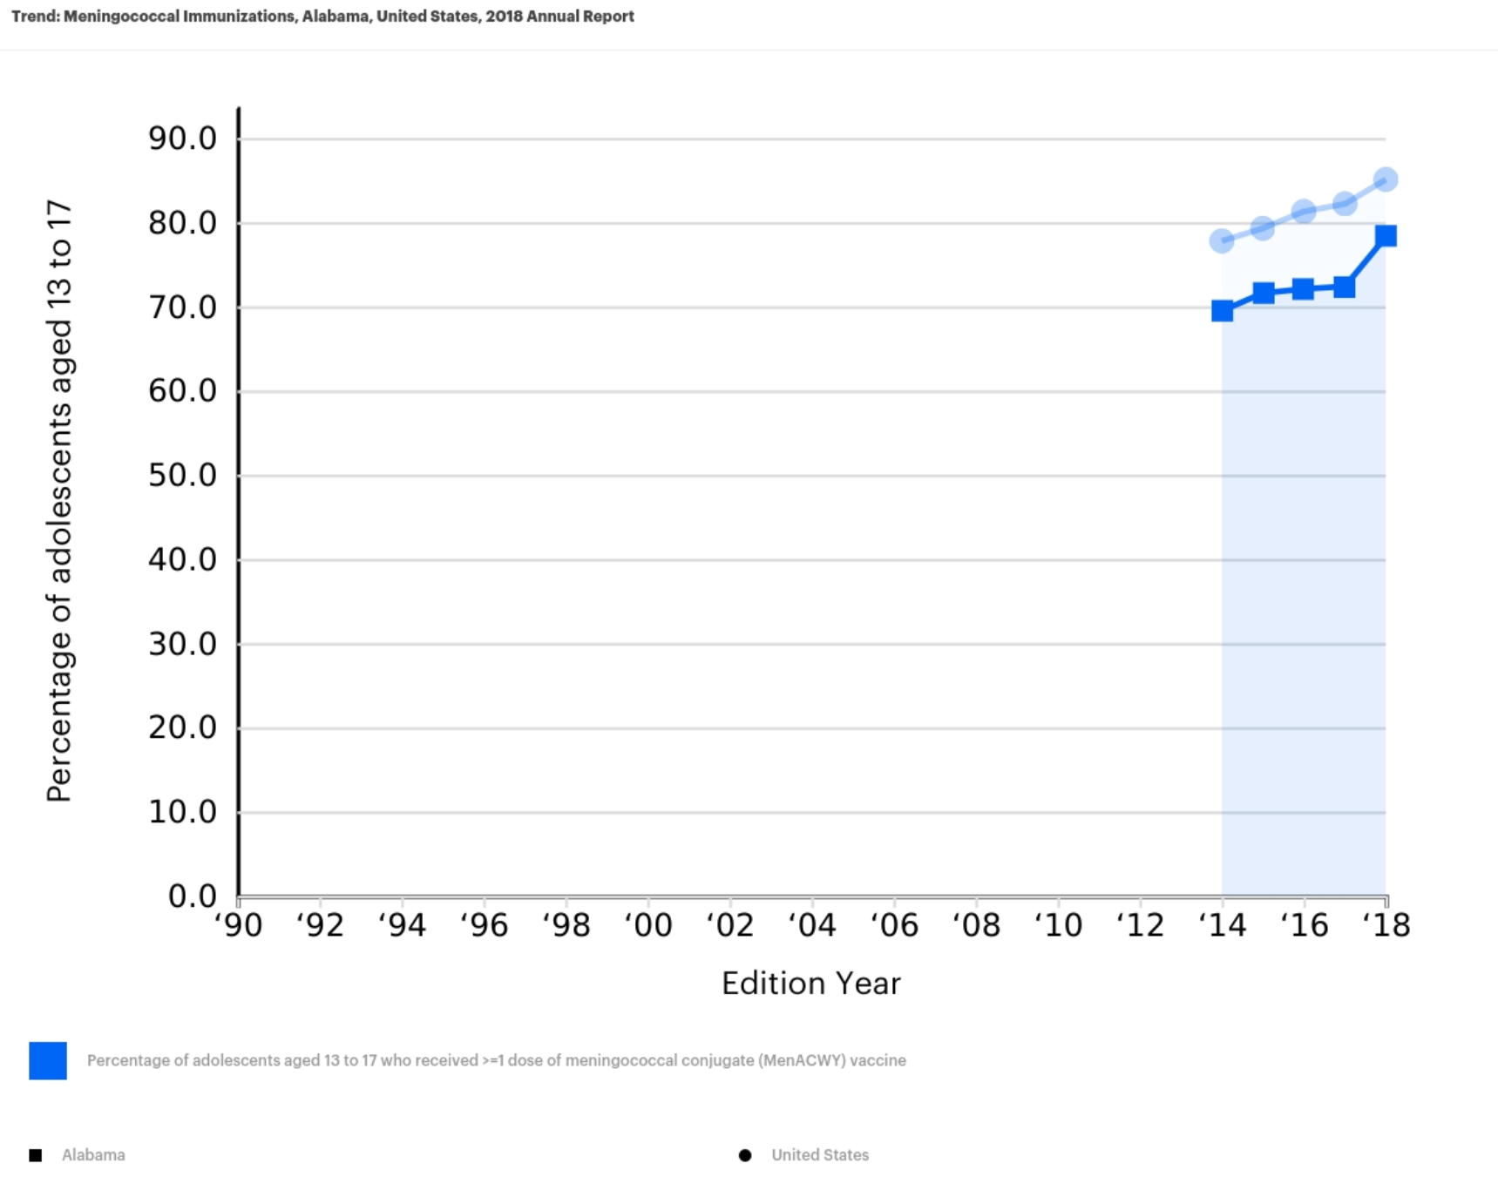
Adolescent Vaccination Rates
2014-18 Percentage Tdap Completion 13-17yo, AL
2014-18 Percentage Meningococcal. Completion 13-17yo, AL

Slide 12
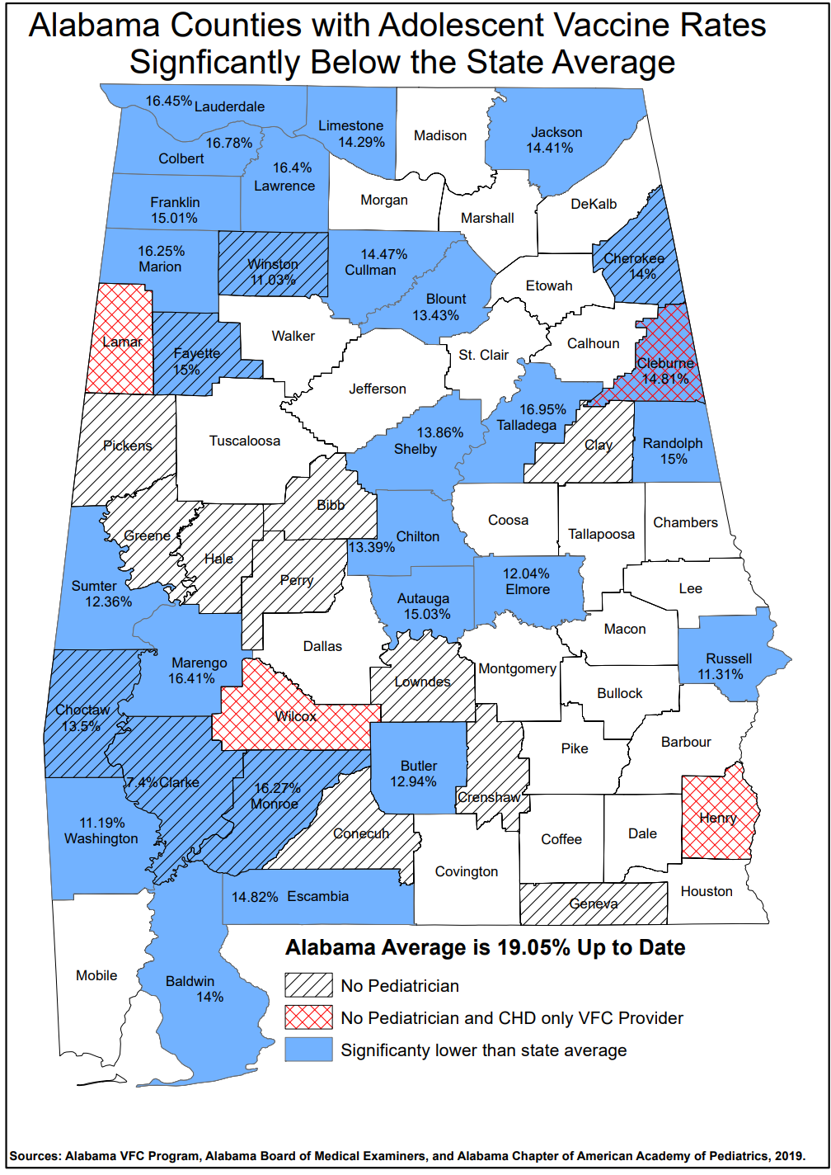
AL Rates of HPV Vaccination
Alabama Average: 19.05%
Half of counties: significantly below this average

